Slide 1
Welcome to Team 07 Church Conference Website Project…
By: Suamy H., Alicia M., and Maden E.
Welcome! Today is Tuesday December 05
Start here

Slide 2
Introduction
Develop a web-based application to facilitate the registration and management of multiple church conferences. Online registration for attendees and admins must be available. Apps must also be able to support both Admin and Regular users.
Key technologies used:mySQL, HTML, Apache, and PHP are the four technologies that we utilized for this project.
Notes:
Maden

Slide 4
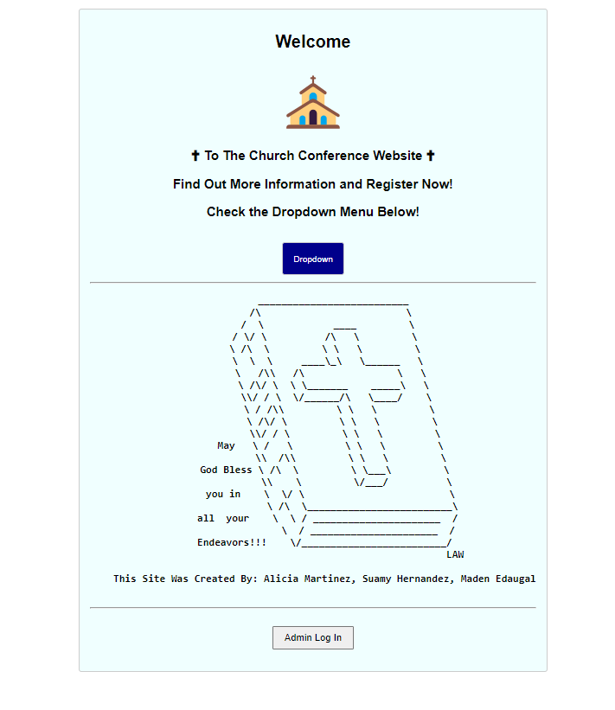
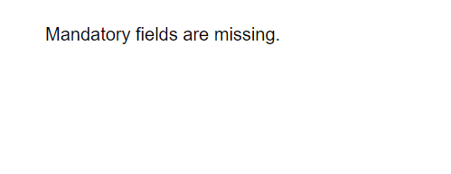
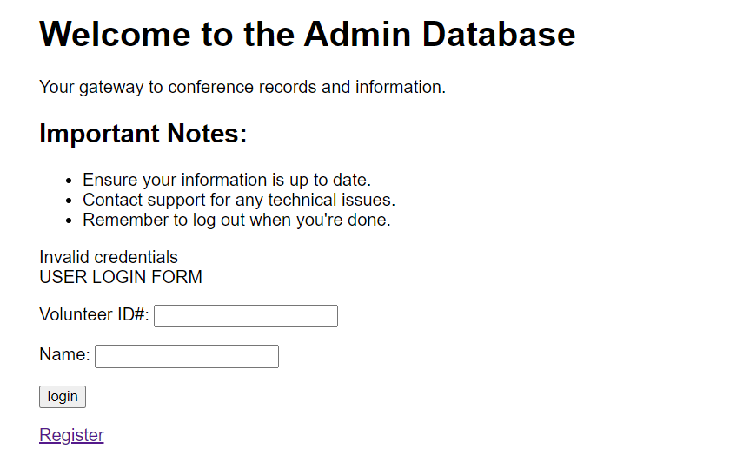
Website + Test Cases
Notes:
Alicia

Slide 5
Contributions
Suamy Hernandez: mySQL codes, Modification and Indexes, ER Diagram, Read-me, SQL views
Alicia Martinez: PHP Files (Register, Index, , mySQL Database Schema & ER Diagram,
Maden Edaugal: Database Schema Constraints, Attributes, PHP Files (Admin Login, Register), User Guide Installation
Notes:
Suamy

Slide 6
Database Design
Implementation Details
User Interface Design
SQL Views and Operation
Technologies Used
Challenges and Solutions
User Guides and Installation
Conclusion
MySQL Screenshot
PHP Screenshots

Slide 7
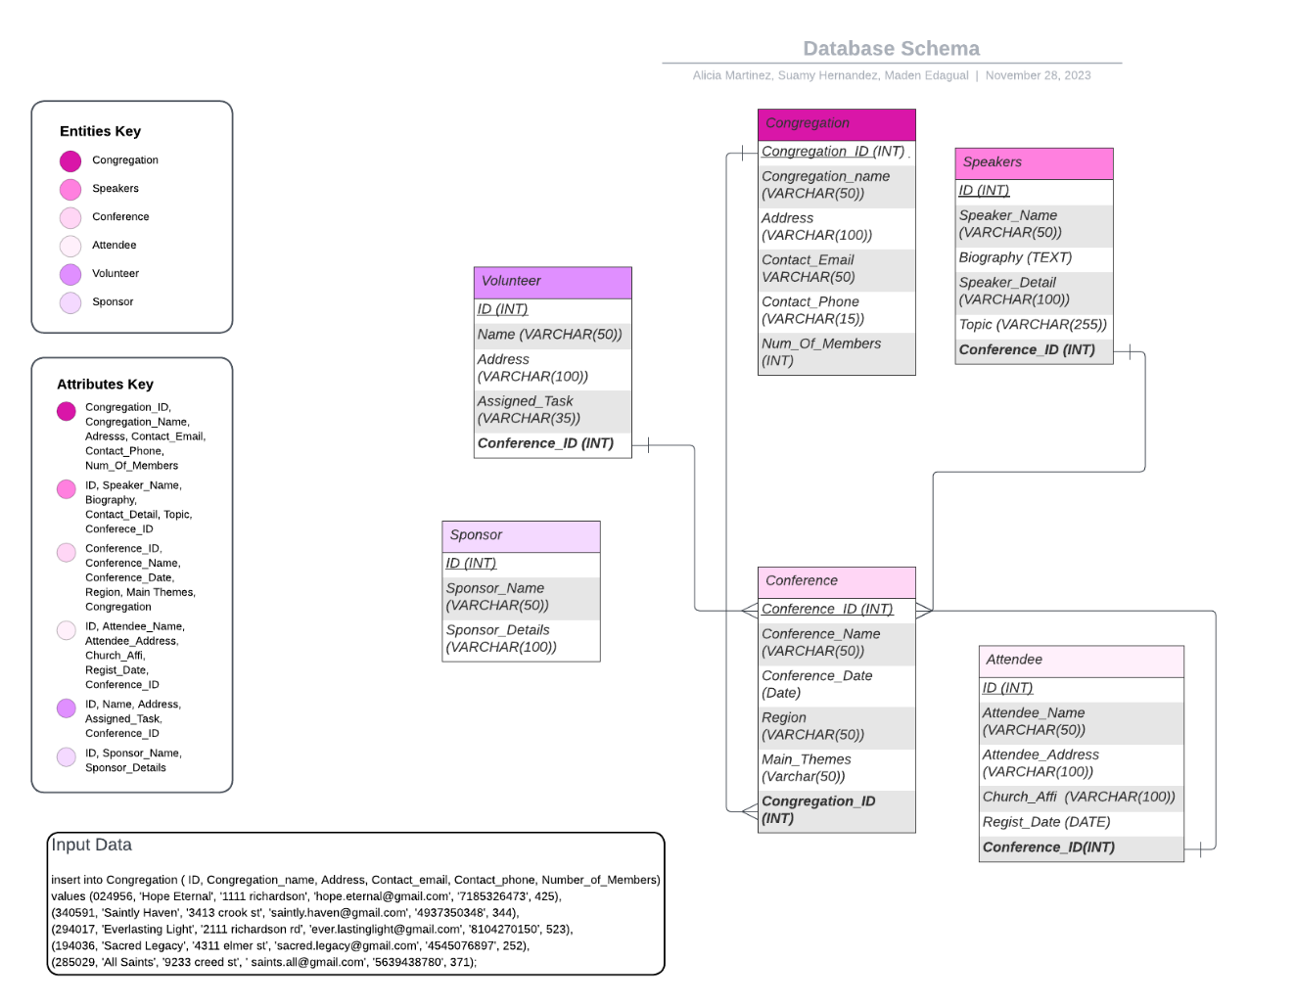
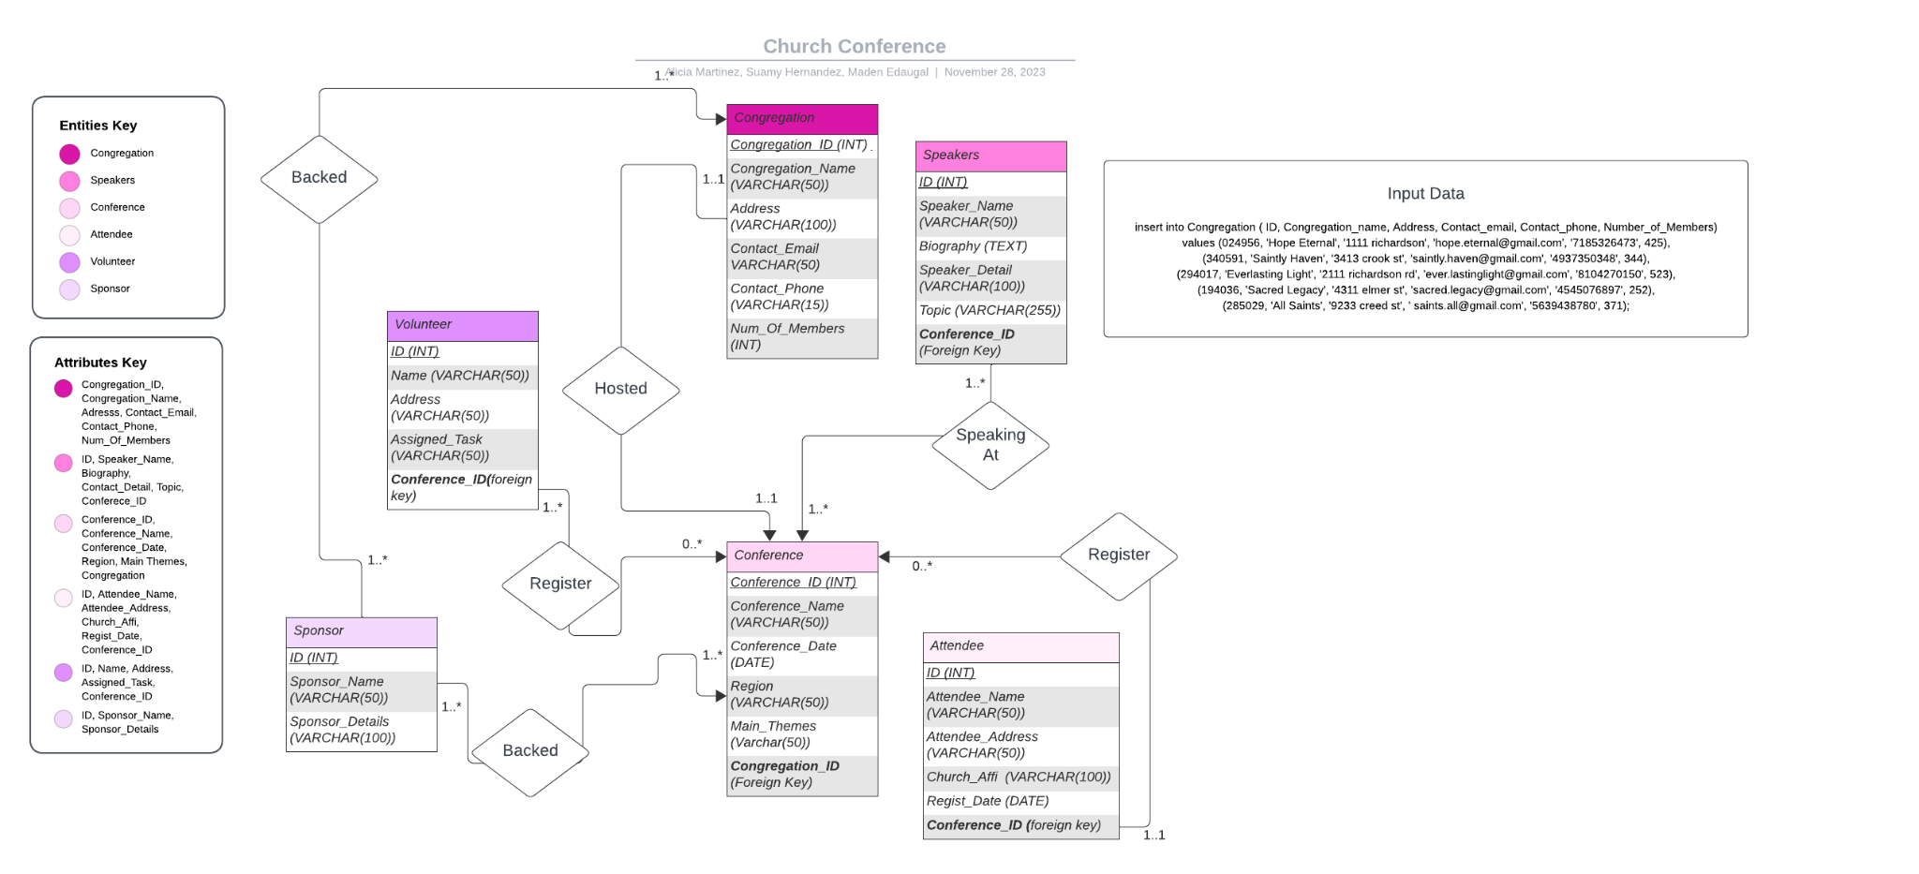
Database Design
Database Design
ER Diagram(left) & Database Schema (right)
Database Entities & Attributes
Database Relationships
Database Constraints
Notes:
Alicia

Slide 8
Implementation Details pt 1
Implementation Details
Congregation
congregation_ID: The constraint has to be not null as it is a primary key. It also has an integer field type.
congr_Name: The field type is varchar(50). The maximum is 50 characters for a name.
congre_Addressi: The field type is varchar(95). The maximum is 95 characters for address.
Contact_email: The field type is varchar(50). The maximum is 50 characters for an email address.
Contact_phone: The field type is varchar(15). The maximum is 15 characters.
Num_of_members: The field type is an integer.
Conference
conference_ID: The constraint has to be not null as it is a primary key. It also has an integer field type.
conf_Name: The field type is varchar(50). The maximum is 50 characters for a name.
conf_Date: The field type is Date.
Region: The field type is varchar(45). The maximum is 45 characters for a region.
Main_theme: The field type is varchar(50). The maximum is 50 characters for a main theme.
Congregation_ID (foreign key): Congregation_ID is a foreign key of the sponsor. Each conference is backed by a sponsor.
Speaker
speaker_ID: The constraint has to be not null as it is a primary key. It also has an integer field type.
speaker_Name: The field type is varchar(50). The maximum is 50 characters for a name.
Biography: The field type is varchar(100). The maximum is 100 characters for a biography.
Speaker_contact: The field type is varchar(100). The maximum is 100 characters for a contact detail.
Topic: The field type is varchar(50). The maximum is 50 characters for a topic.
Conference_ID (foreign key): Conference_ID is a foreign key of a conference. Each speaker is speaking at a conference.
Attendee
attendee_ID: The constraint has to be not null as it is a primary key. It also has an integer field type.
attendee_Name: The field type is varchar(50). The maximum is 50 characters for a name.
attendee_Address: The field type is varchar(100). The maximum is 100 characters for an address.
Church_affi: The field type is varchar(100). The maximum is 100 characters for a church affiliation.
Regist_date
Conference_ID (foreign key): Conference_ID is a foreign key of a conference. Each attendee can register for a conference.
Volunteer
volunteer_ID: The constraint has to be not null as it is a primary key. It also has an integer field type.
volun_Name: The field type is varchar(50). The maximum is 50 characters for a name.
volun_Address: The field type is varchar(100). The maximum is 100 characters for an address.
Assigned_task: The field type is varchar(35). The maximum is 35 characters for an assigned task.
Conference_ID (foreign key): Conference_ID is a foreign key of a conference. Each volunteer can register for a conference.
Sponsor
sponsor_ID: The constraint has to be not null as it is a primary key. It also has an integer field type.
sponsor_Name: The field type is varchar(50). The maximum is 50 characters for a name.
Sponsor_contact: The field type is varchar(100). The maximum is 100 characters for contact details.
Relational Database Schema and Constraints (right image)
Data Definition Language
Schemas allow for faster implementation with attributes already known
Notes:
Maden

Slide 9
Implementation Details pt2
Data Manipulation Language
Five values inserted into Congregation (right)
SQL Modification and Indexes
Schemas allow for faster implementation with attributes already known
insert into Congregation ( ID, Congregation_name, Address, Contact_email, Contact_phone, Number_of_Members)
values (024956, 'Hope Eternal', '1111 richardson', 'hope.eternal@gmail.com', '7185326473', 425),
(340591, 'Saintly Haven', '3413 crook st', 'saintly.haven@gmail.com', '4937350348', 344),
(294017, 'Everlasting Light', '2111 richardson rd', 'ever.lastinglight@gmail.com', '8104270150', 523),
(194036, 'Sacred Legacy', '4311 elmer st', 'sacred.legacy@gmail.com', '4545076897', 252),
(285029, 'All Saints', '9233 creed st', ' saints.all@gmail.com', '5639438780', 371);
Notes:
Made

Slide 10
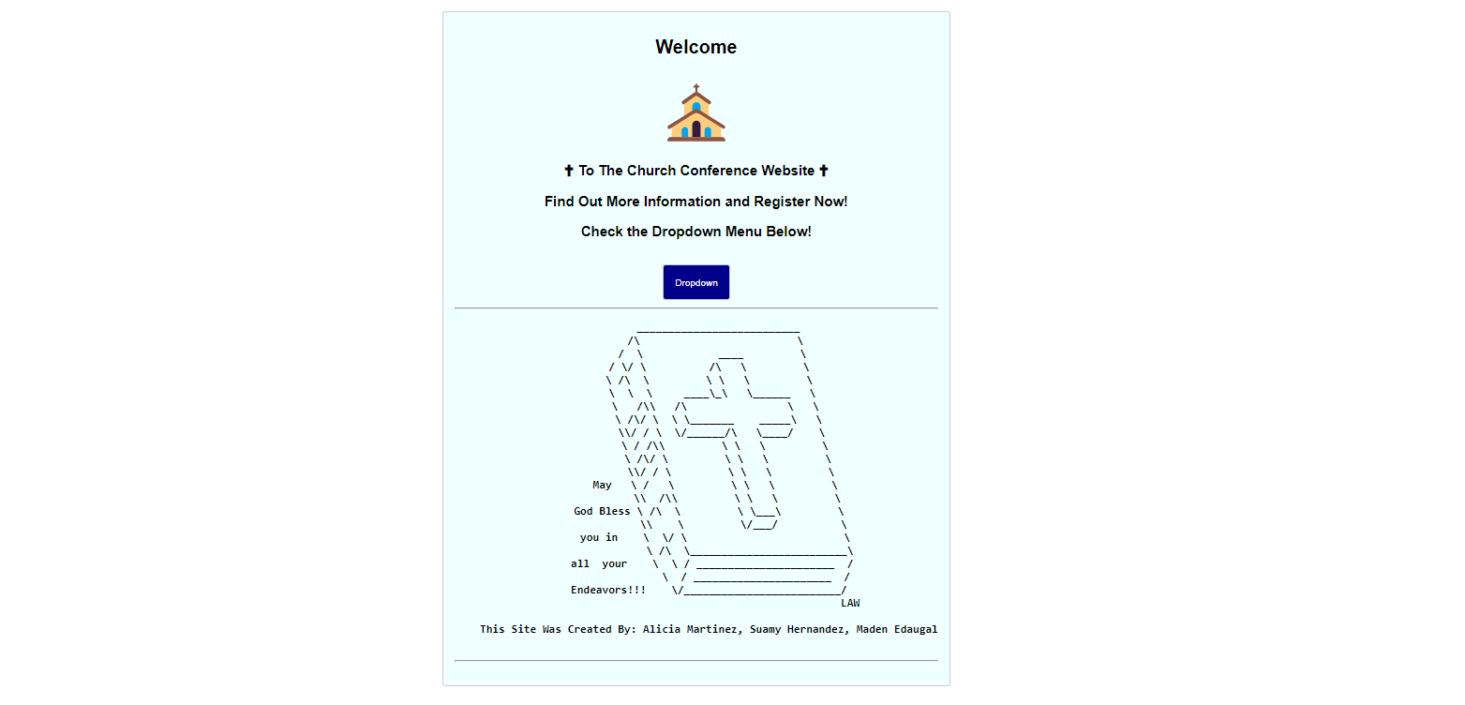
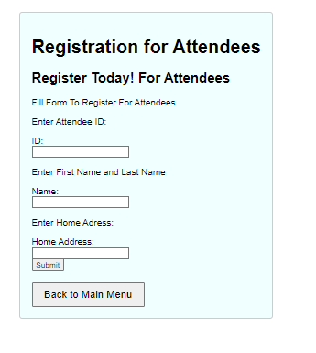
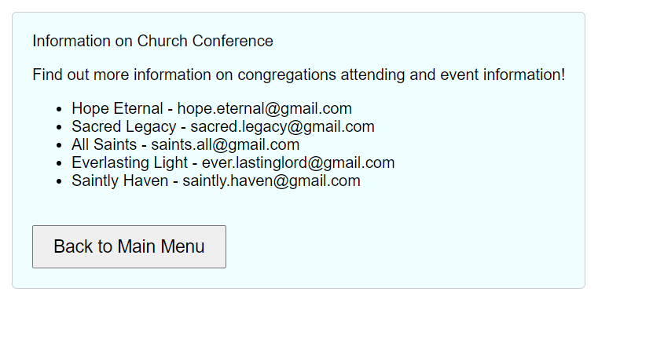
User Interface Design
User Interface Design
Utilization of user interface elements like a dropdown button, buttons and CSS stylings create a user-friendly atmosphere.
Notes:
Alicia

Slide 11
SQL Views and Operation
SQL Views and Operation
UPDATE congregation
SET Number_of_Me mbers= 500
WHERE ID= 024956;
For this query, what was done is that it will update the congregation table. What is going to be updated is the Number_of_Members which changes to 500. where specifically? for the ID number 024956.
INSERT INTO Sponsor (ID, Sponsor_Name, Sponsor_Details)
VALUES( 100123, ‘bayou city fellowship’, ‘located in bayou city’);
For this query, what is being done is that new values will be inserted into the table Sponsor. which include: the id number, sponsor name, and the sponsor details.
UPDATE Sponsor
SET Sponsor_Details= ‘located in bayou city with a devoted community willing to preach about the lord'
WHERE ID= 100123;
For this query, what was done is that the Sponsor table was updated. what was specifically updated was the sponsors details, that belong to the ID 100123.
UPDATE Congregation
SET Contact_Email= ‘ever.lastinglord@gmail.com’
WHERE ID= 294017
For this query, what was done is that the Congregation table was updated with new information. The specific information updated was the contact email for the ID number 294017
INSERT INTO Conference (ID, Conference_name, Conference_date, Region, Main_Theme, Congregation_ID)
VALUES (930218, 'Norris center', '2023-12-01', 'Texas', 'Love thy neighbor', 024956);
For this query, we inserted new values into the table named Conference. The specific things added are: the ID, Conference_Name,Conference_Date, Region, Main_Theme, and the congregation ID.
UPDATE Conference
SET Conference_date = '2023-12-03'
WHERE ID = 930218;
For this query, we updated the conference date for the ID 930218 in the conference table.
INSERT INTO Speaker (ID, Speaker_name, Biography, Speaker_details, Topics, Conference_ID)
VALUES (193357, 'Joel Osteen', 'American pastor, televangelist, businessman and author based in Houston, Texas', 'Devoted pastor and to his community at lakewood church', 'learning to love thy enemies', 930218);
For this query, we inserted new values for the Speaker table. The new values consist of the ID, speaker name, biography, speaker details, topics, and the conference ID.
UPDATE Speaker
SET Topics = 'learning to forgive and let go'
WHERE ID = 193357;
For this query, we updated the topics for the ID 193357 in the speakers table.
INSERT INTO Attendee (ID, Attendee_name, Attendee_address, Church_Affiliation, Registration_Date, Conference_ID)
VALUES (412003, 'marc anthony', '2231 drury lane', 'Redeemer church', '2023-11-16', 930218);
For this query, we inserted new values into the Attende table. The new values consist of the id number, attendees name, the attendees address, the church they are affiliated with, the date they registered and the conference ID number.
UPDATE Attendee
SET Church_Affiliation = 'Southwind Baptists'
WHERE ID = 412003;
For this query, we updated the church affiliation for the ID 412003 in the attendee's table.
Two specific SQL views for real time insights(left)
10 SQL Queries for common operations (right)
CREATE VIEW Attendee_info AS
SELECT Attendee_name, Registration_Date, Conference_ID
FROM Attendee
WHERE Registration_Date >= CURDATE(); Attendee_info will obtain attendees name along with their conference ID only for those who are registered on or after the current date.
CREATE VIEW Conference_info AS SELECT Conference_name, Conference_date, ID
FROM Conference
WHERE Conference_date >= CURDATE(); Conference_info will obtain the conference's name, associated ID for conferences that are registered on or after the current date.
Notes:
Suamy

Slide 12





Technologies Used
Technologies Used
mySQL: stored and managed data information along with its relationship.
PHP: Handled server side logic. Embedded within HTML code.
HTML: Structures the content of the website
Apache: Serves and manages request across mySQL, PHP And HTML.
CSS: Some CSS code were embedded specially in the beginning with the blue background and fonts.
Notes:
Suamy

Slide 13
Challenges and Solutions
Challenges and Solutions
Most of the challenges we’ve faced were from PHP itself as it was a newer concept to us. We struggled with implementing login and registering pages for admin/volunteers and regular visitors and allowing them to update our SQL tables we managed to overcome some of these challenges and were able to learn a lot from it.
We also struggled with understanding how to implement certain aspects like connecting mySQL files to the PHP files. We struggled with other aspects to overcome this we spoke with Dr. Mardini. We implemented the necessary changes in our project.
We learned how to develop forms and dropdown buttons with HTML and using these skills we implemented what we could into our project. We used resources provided by Dr. Mardini and also used other sources like videos and other educational resources like W3 schools for HTML and PHP.
Notes:
All

Slide 14
User Guides and Installation
User Guides and Installation
Extract all files.
Open mySQL. Workbench and connect to your local mySQL. server. Open the SQL script file named create_user_fantastic7.sql, db_church_script.sql, and church_project_alicia_suamy_maden.sql. The first SQL file will create a new user fantastic7@localhost. The second file will be The third file will execute the SQL statements in the script to create six tables 'Congregation’, ‘Speakers’, ‘Volunteer’, ‘Sponsor’, ‘Conference’, and ‘Attendee’. Additionally, it will insert some initial data into them.
Visit XAMPP Download Page to download the XAMPP installer. During installation, make sure to install it to C:\xampp for easier file management. Once the installation is complete, launch the XAMPP control panel and start Apache and mySQL..Navigate to C:/xampp/htdocs/ in your file explorer and place the PHP files (index3.php, info.php, and Register.php) from Step 2 into this folder.
Open your web browser and go to http://localhost/index3.php.
Notes:
Maden

Slide 15
Conclusion…
Conclusion
In the future, we would like to use our time to be able to improve log-in features for our users and admin. Along with that, we would like to make a better registration page and allow users to be able to create a user and password as of right now to register and log in all that is needed we would like to improve the form and allow for more information to be placed by the user.
Along with that, we would like to add more pages to our website, with more information on conferences, speakers, and sponsors. We would also like to include images regarding our conference logos, artwork, and photos and use a wider variety of fonts.
With the current experience we have gained, we learned a lot about HTML, MYSQL, and PHP so much so that we would love to carry on this knowledge into our future projects
Notes:
All

Slide 16
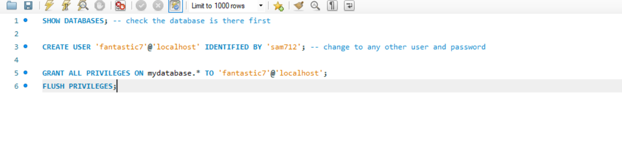
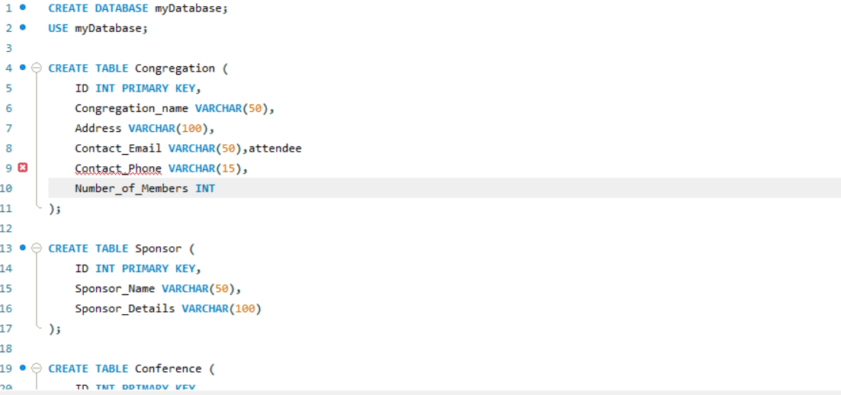
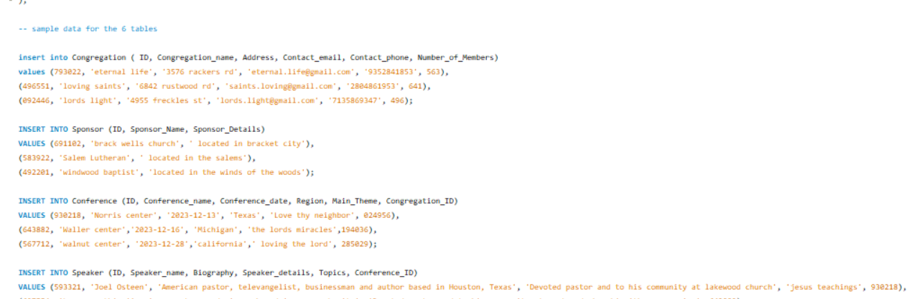
MySQL Screenshots
Notes:
suamy

Slide 17
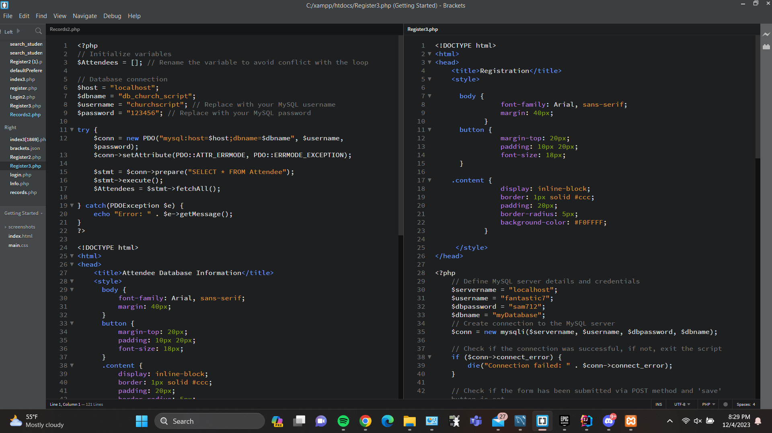
PHP Screenshots
Notes:
Alicia

Slide 18

Thank you! Questions?
Citations:
https://www.w3schools.com/php/default.asp
Reference for php information we used
https://www.w3schools.com/charsets/ref_utf_symbols.asp
Reference for symbols used
https://www.asciiart.eu/religion/christianity
Reference for biblical ascii art used in index page
https://www.w3schools.com/howto/howto_css_dropdown.asp
Reference for dropdown button html work

